Slide 1
Searching and Sorting
NOTES

Slide 2
Linear Search (Code)
// To search for key in arr using linear search
// Return index if found; otherwise return -1
int linearSearch(int arr[], int size, int key) {
int i;
for (i=0; i<size; i++)
if (key == arr[i])
return i;
return -1; // not found
}

Slide 3
Binary Search (Algorithm)
(Pre-condition: list is sorted in ascending order)
Look for the key in the middle position of the list.
Either of the following 2 cases happens:
If the key is smaller than the middle element, then “discard” the right half of the list and repeat the process.
If the key is greater than the middle element, then “discard” the left half of the list and repeat the process.
Terminating condition: either the key is found, or when all elements have been “discarded”.

Slide 4
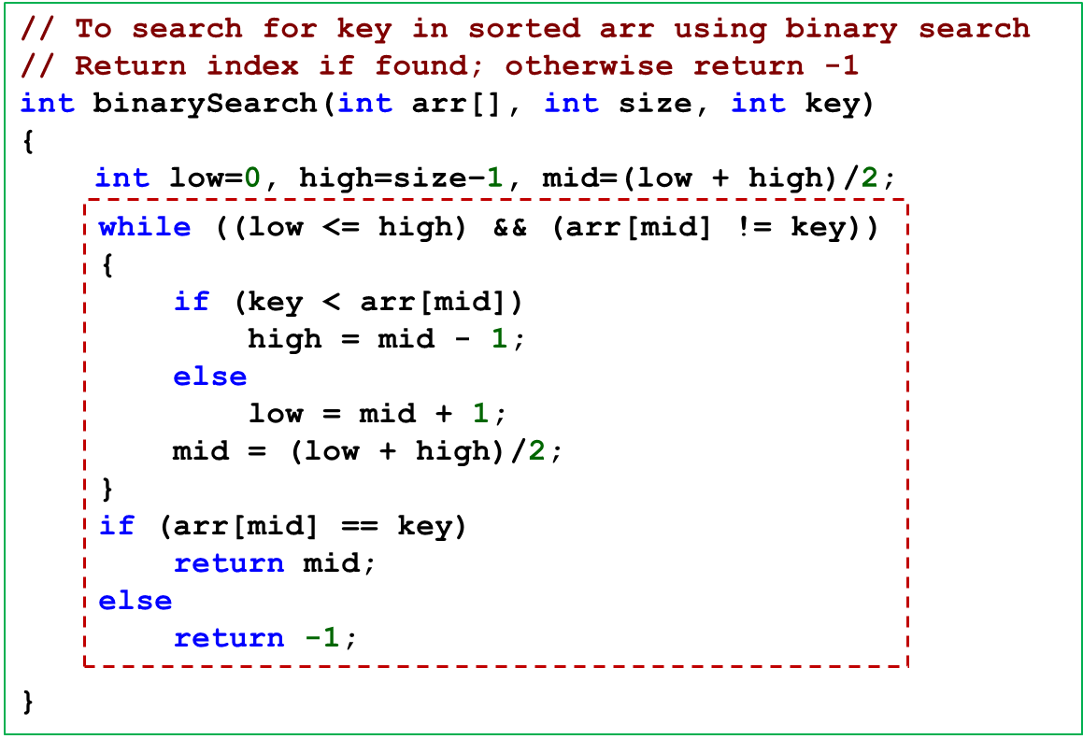
Binary Search (Code)

Slide 5
Selection Sort (Algorithm)
Step 1: Find the smallest element in the list.
Step 2: Swap this smallest element with the element in the first position. (Now, the smallest element is in the right place.)
Step 3: Repeat steps 1 and 2 with the list having one fewer element (i.e. the smallest element just found and placed is “exempted” from further processing).

Slide 6
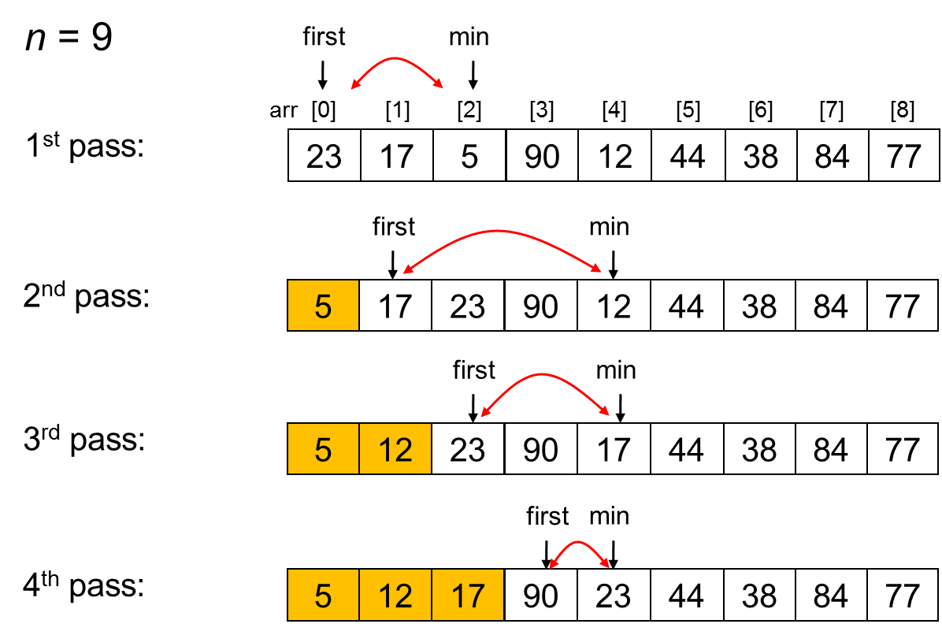
Selection Sort (Part 1)

Slide 7
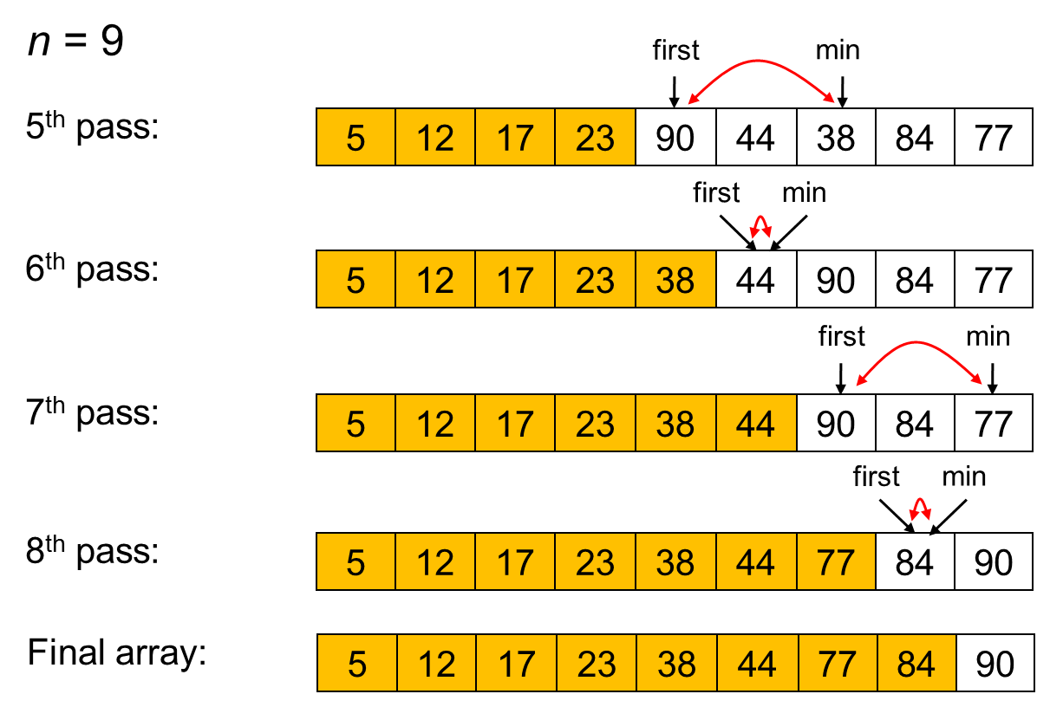
Selection Sort (Part 2)

Slide 8
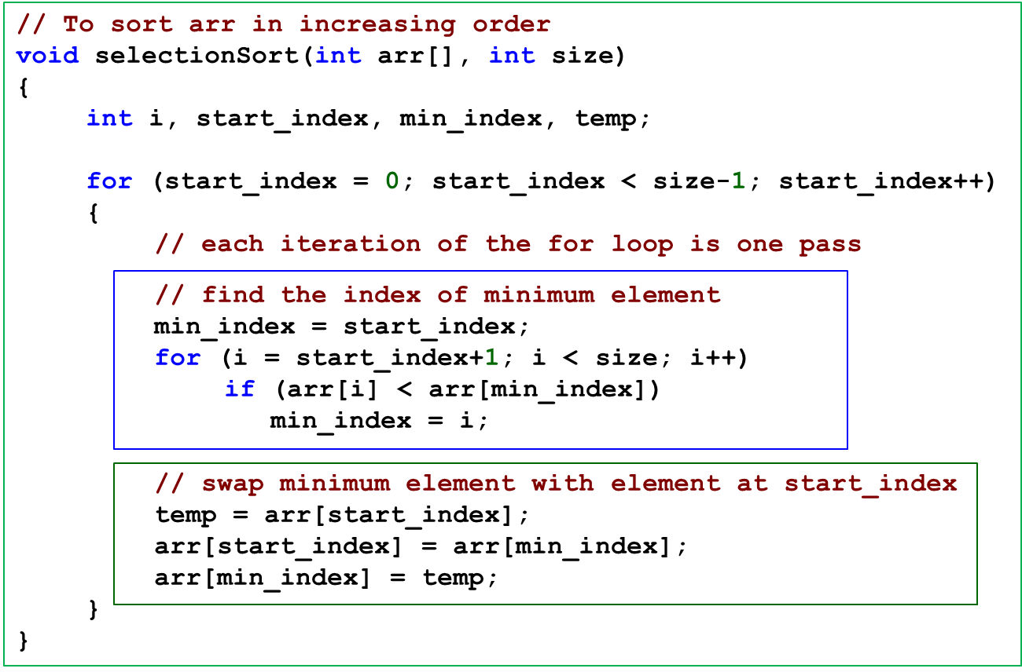
Selection Sort (Code)

Slide 9
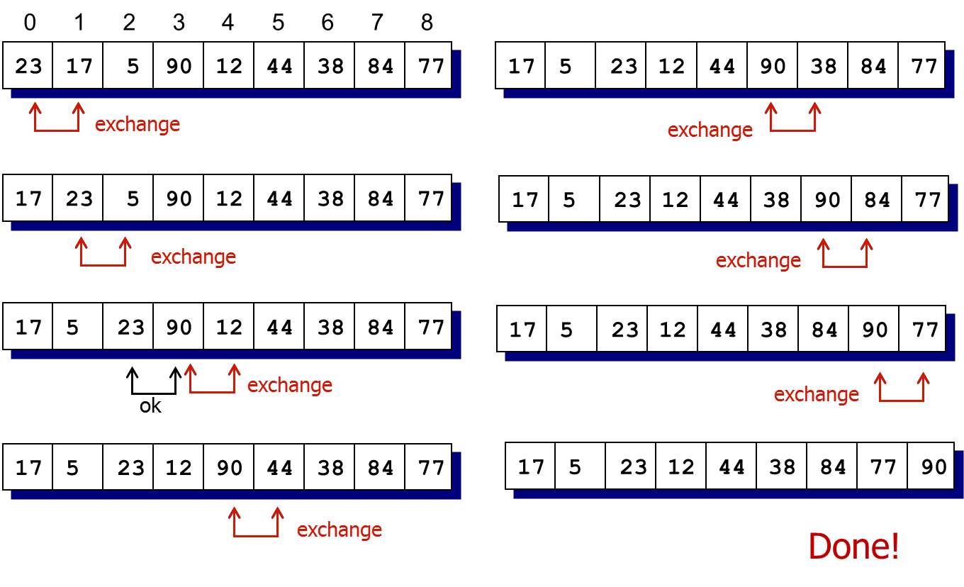
Bubble Sort (Algorithm)

Slide 10
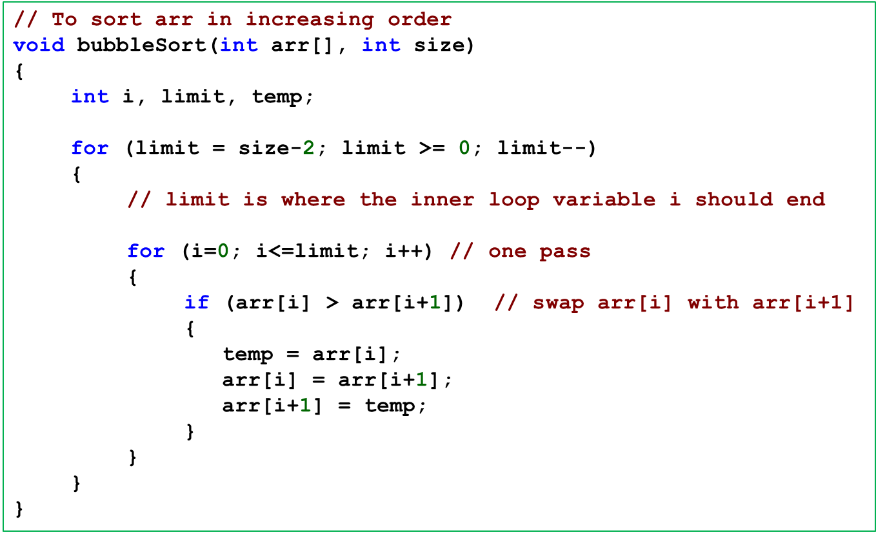
Bubble Sort

Slide 11
